Slide 1


AlBorg Laboratories App UI/UX Transformation

Slide 2
Teams Member
Asmaa Zakarya: Home Page & Documentation
Nagat Ali Elbastawise: Profile Page & result
Rasha Emad Mansour: Visit Page & Documentation
Salma Rafat Anwar: Branches & Tests
Asmaa Hany Saeed: Health Tips & Presentations

Slide 3
About Project
-This project is based on Al Borg Laboratories and focuses on redesigning the existing system to enhance the overall user experience. The motivation behind choosing this case study is the need to improve the current system, as the user interface lacks clarity, has inefficient navigation, and does not provide a modern user experience
-The redesigned system aims to offer a more intuitive, efficient, and user-friendly experience by applying Human–Computer Interaction (HCI) principles, ensuring better usability, accessibility, and visual consistency for users.

Slide 4
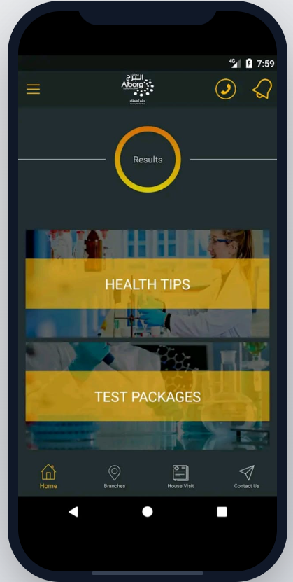
HOME PAGE
Poor Visual Hierarchy
“The interface lacks a clear visual hierarchy, making it difficult for users to identify the most important actions.”
Unclear Call-to-Action
“The ‘Results’ section is presented as a circular element without clear indication that it is clickable.”
Inconsistent Icon Style
“ Icons vary in size and visual style, leading to inconsistency in the interface design.”
Low Text Readability
“Text placed over images reduces readability due to insufficient contrast between text and background.

Slide 5
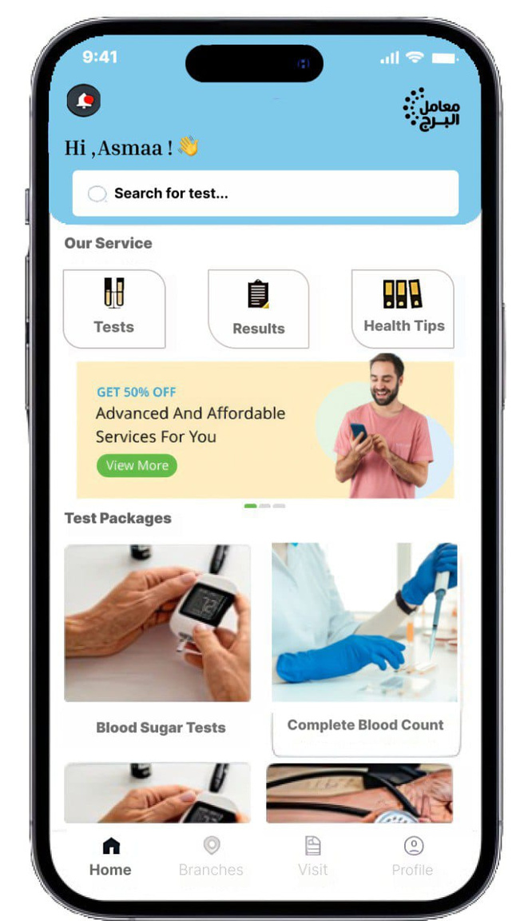
Enhanced solutions
The new interface uses consistent icon styles and sizes, creating a more cohesive and professional look.
The redesigned UI follows modern design principles such as card-based layouts, soft shadows, and minimalistic elements
Clear call-to-action buttons such as ‘view more’ are now highlighted, making user actions more intuitive

Slide 6
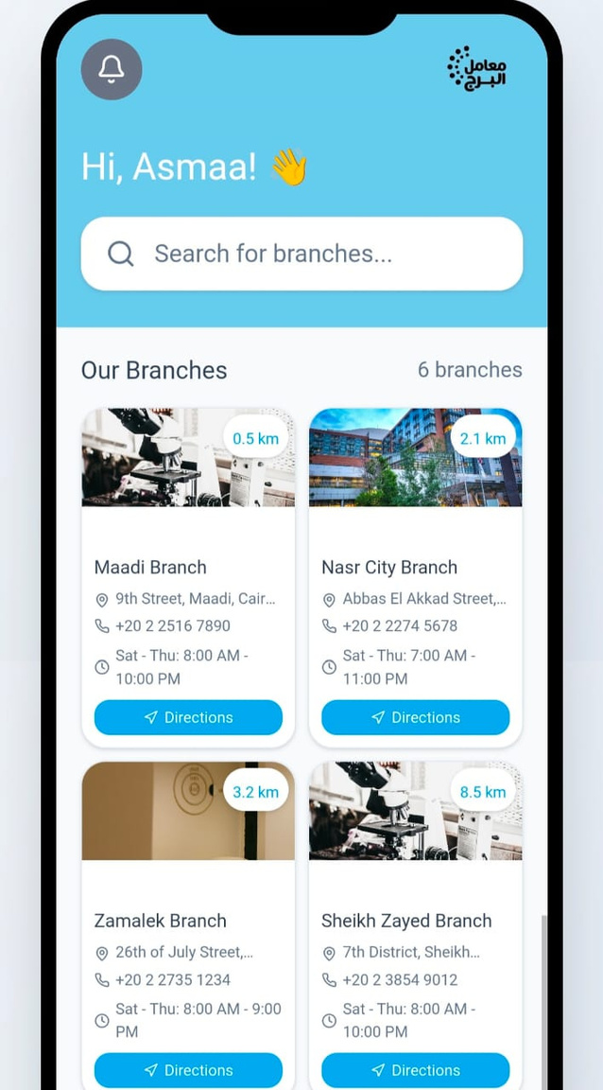
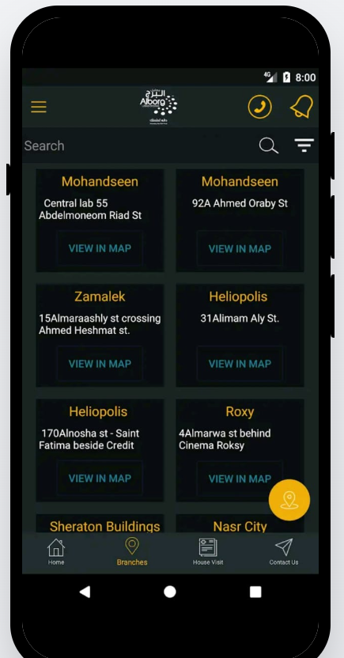


Branches Screen
After
Color & Visual Identity:
Light colors (blue and white) were used to reflect cleanliness and trust, which aligns with medical application standards
Before
Branches Layout:
The traditional list view was replaced with card-based design that includes branch images and key information.
Distance Feature:
Displaying the distance (in km) between the user and each branch helps users quickly choose the nearest location.

Slide 7
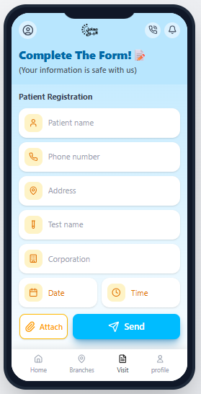
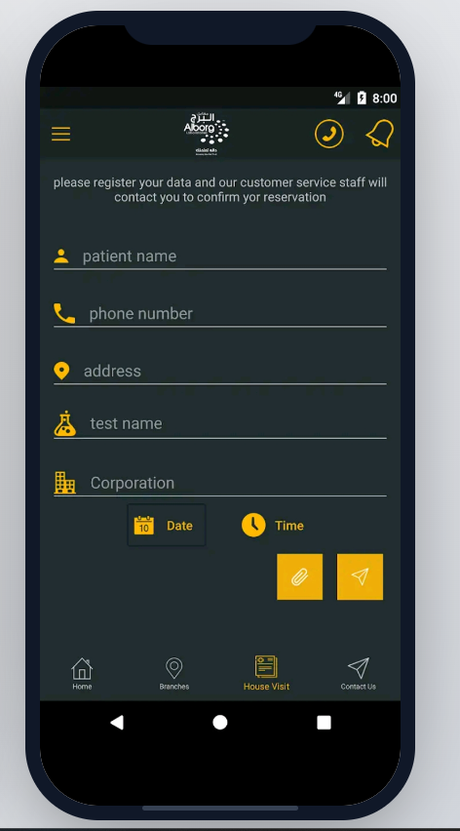
visit Screen
After
Before
How personalized healthcare is revolutionizing treatment plans
Improved Readability and Clarity:
The light colors and card-style fields make the form easier to read and look cleaner.
Better User Guidance and Fewer Errors:
Icons and spacing guide the user and help prevent mistakes.
More Intuitive and Efficient Interaction:
Main buttons like Send, Attach, Date, and Time are easy to find and use

Slide 8
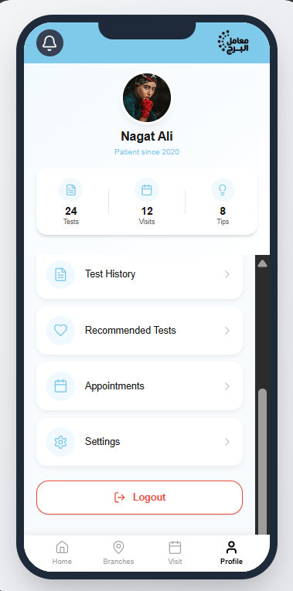
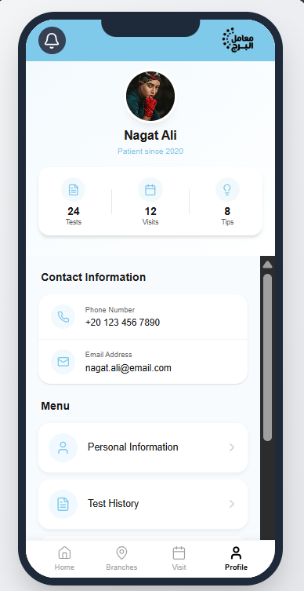
New features
Profile screen:
This page was not available in the original application and was added to enhance the user experience and improve functionality
It provides a centralized place where the user can access and manage important information, including:
personal information: Allows the user to view and manage their personal and contact details, making the profile more organized and easier to maintain.
Appointments Booking: Enables the user to book, view, and manage appointments in one place, which helps save time and reduces confusion.
Number of Tests: Displays the total number of tests taken by the user, giving a clear overview of their medical activity.
Test History and Dates: Shows previous tests along with their dates, allowing users to easily track their medical records over time.

Slide 9
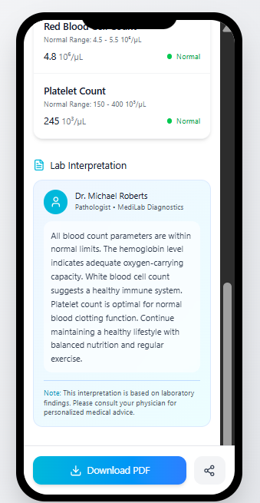
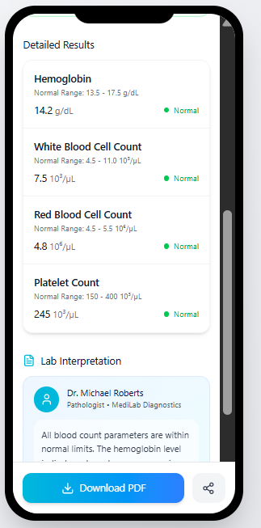
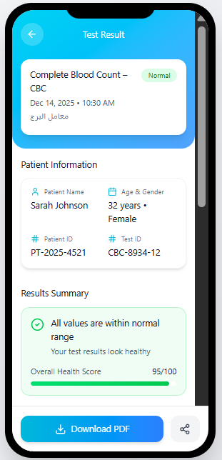
New features
Results Page
This feature was not included in the original application. It was added to enhance the user experience and make the app more user-friendly
The page include:
Patient information panel including name, age, gender, and test details.
Results summary and health score that gives a quick overall assessment of the user’s health.
Detailed lab results showing values such as hemoglobin, red blood cells, white blood cells, and platelet count.
Normal range indicators to easily identify whether results are within the healthy range.
Lab interpretation section that explains the results in a simple and understandable way.

Slide 10
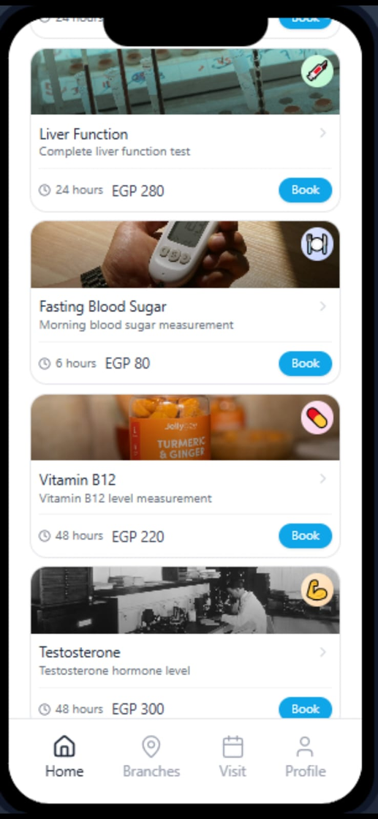
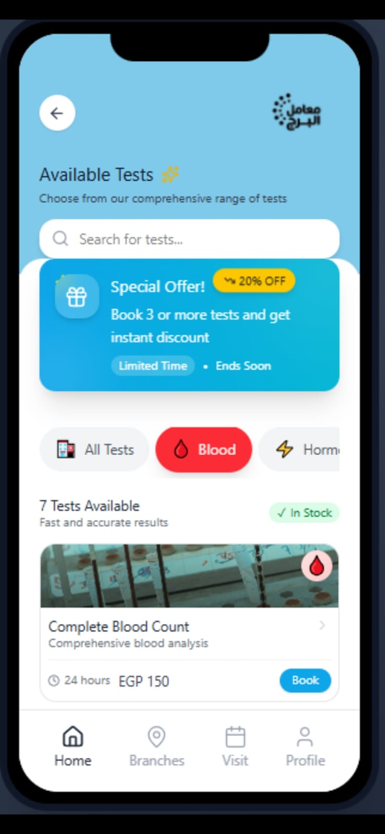
Tests Page
This page is designed to help users easily book their medical tests through a clear and organized interface. Users can browse available tests, select the required test, and choose a suitable date and time with minimal effort. The system aims to reduce confusion and save time by providing a smooth and user-friendly booking experience, while keeping all test appointments well-organized and easy to access

Slide 11
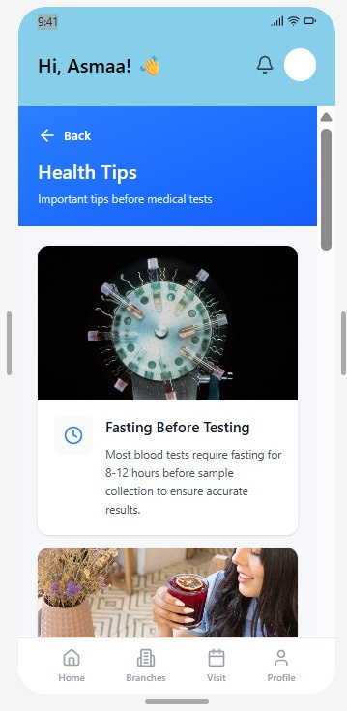
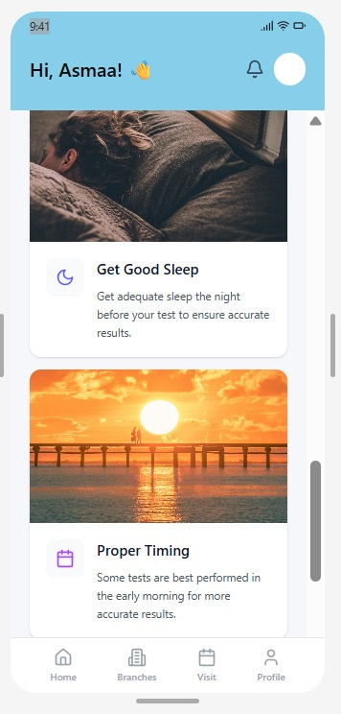
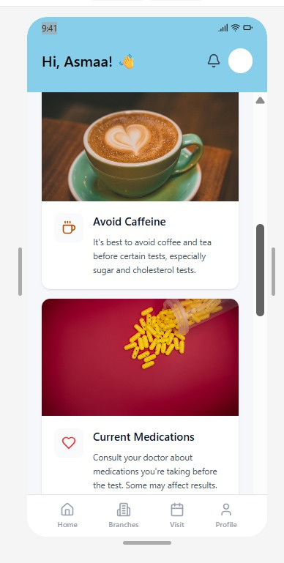
Health Tips Page
Because your well-being matters:
This section provides easy and practical health tips to help users adopt healthier habits in their daily lives. The goal is to promote overall well-being through simple guidance that is easy to understand and applly

Slide 12

Before

Slide 13
After

Slide 14
Thank you for your attention

